Slide 1
Adoption-Centered API Design
Marsh Gardiner, @earth2marsh
Brian Mulloy, @landlessness
Notes:
S: APIs exist so that applications that aren't under your control can safely access your service.
C: Those APIs allow the machines to talk to each other, those applications are written by people—so as soon as your API has gone into production, you have an adoption problem.
I: Therefore, everything you can do to make it easier for people to use your API will accelerate its adoption.
P: So as you design your API, always be mindful about how people will approach your API, and find ways to make it easier for them to use it.
A: Let's walk through this together, and think about the different ways in which developer-centered design can help with your adoption problems
I love APIs.
(hand up) And I have to ask… who here loves APIs?
Because, I have to tell you, you’re at a conference called “I love APIs.” And you’re at an API design talk at that conference. So if you don’t love APIs, you’re in the wrong place. ☺
Why do you love APIs?
If APIs are addictive, and I’m pretty sure they are, Twitter’s API was my gateway drug. Sure, I’d tried some RSS and some web scraping…
Digital vs film cameras. It had to be easy to get at it. Feedback loop.

Slide 2
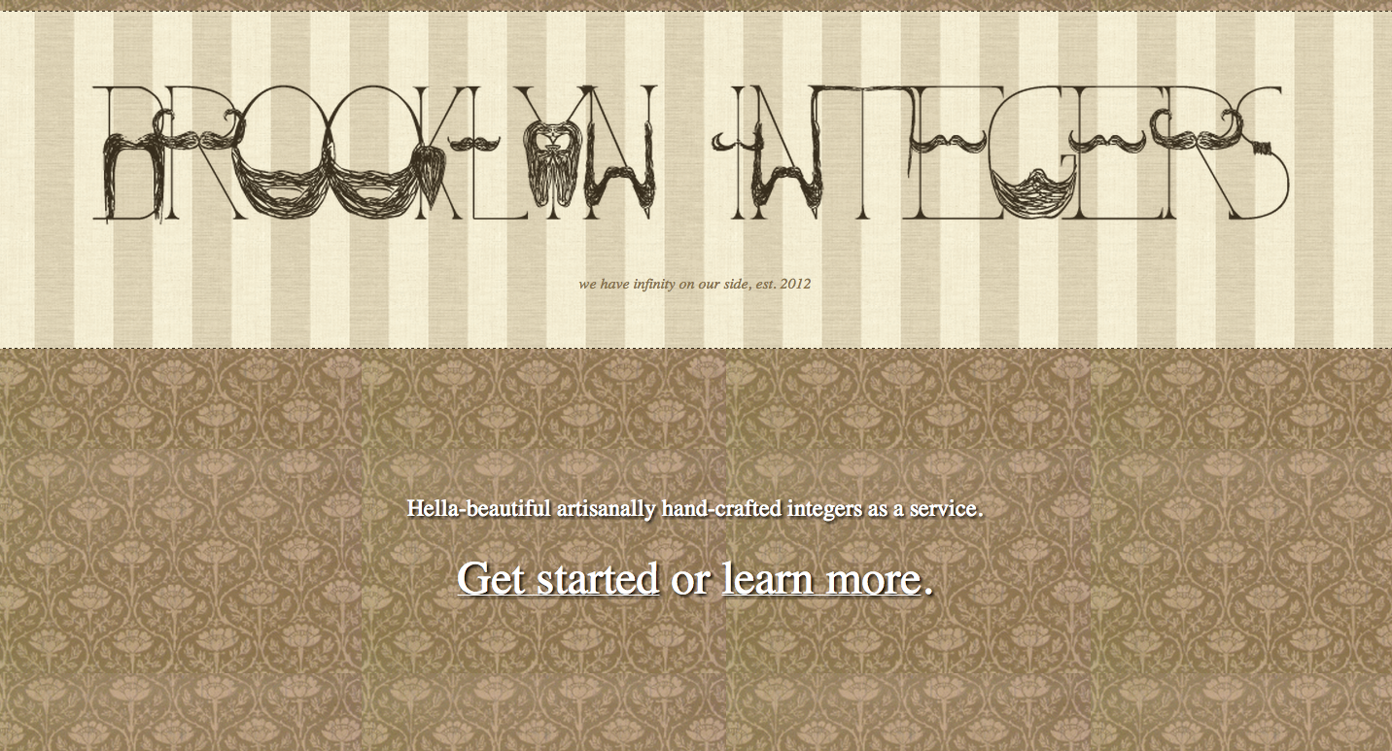



Integers as a Service
Notes:
This is one of my favorite APIs. They’re different than you. They don’t have an adoption problem—because these APIs were built as a complicated API joke.
All the rest of you, you built your APIs as a way to extend the service of your business to applications beyond your walls. Once you push that API to production for the very first time, you have an adoption problem.
http://canalstintegers.com/
http://www.londonintegers.com/
http://www.brooklynintegers.com/
http://www.missionintegers.com/

Slide 3
Overview
How did we get here?
Where are we now?
Where are we going?
How are we going to get there?
Questions
Notes:
A quick overview of what we’ll go through today.

Slide 4
How did we get here?
Notes:
A note on APIs—whenever we mention APIs, assume we mean data being sent between clients and servers rather than device-level APIs. Usually we mean over HTTP.

Slide 5
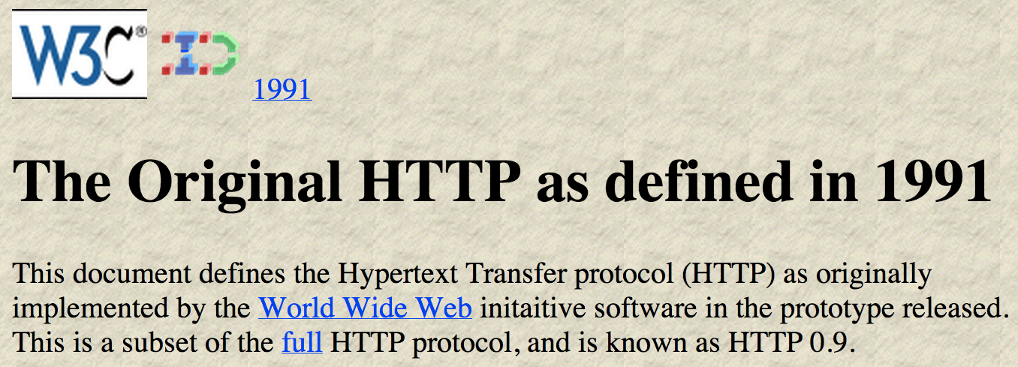
In the beginning…
Notes:
Source: http://www.w3.org/Protocols/HTTP/AsImplemented.html
Super-fast, just so we’re all on the same page…
The web was made of hypertext, which was transported over HTTP. We still feel the influence of the www an APIs today.
Way back then, there was no separation of content and presentation layers… except for one important example: a server could tell the client how to send data back with a form and a POST. URLs were addresses and we had two main verbs—GET and POST, which separated read from write so that server state changes didn’t happen by accident.

Slide 6
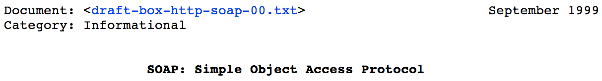
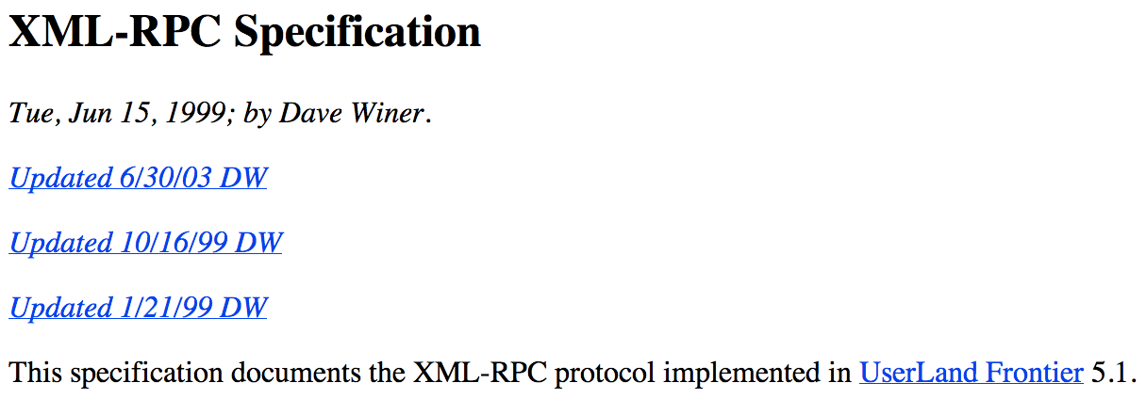
SOAP and XML-RPC
Notes:
1998/99 saw the rise of XML-RPC and SOAP, the dawn of Service-Oriented Architecture. These were the first real web APIs in terms of serializing data for machines. They only really used one verb and one resource, and all the message complexity was hidden “underneath the surface” in the envelope and body of the message.
More info:
RPC: http://xmlrpc.scripting.com/spec.html
SOAP: https://tools.ietf.org/html/draft-box-http-soap-00
History: http://www.xml.com/pub/a/ws/2001/04/04/soap.html

Slide 7
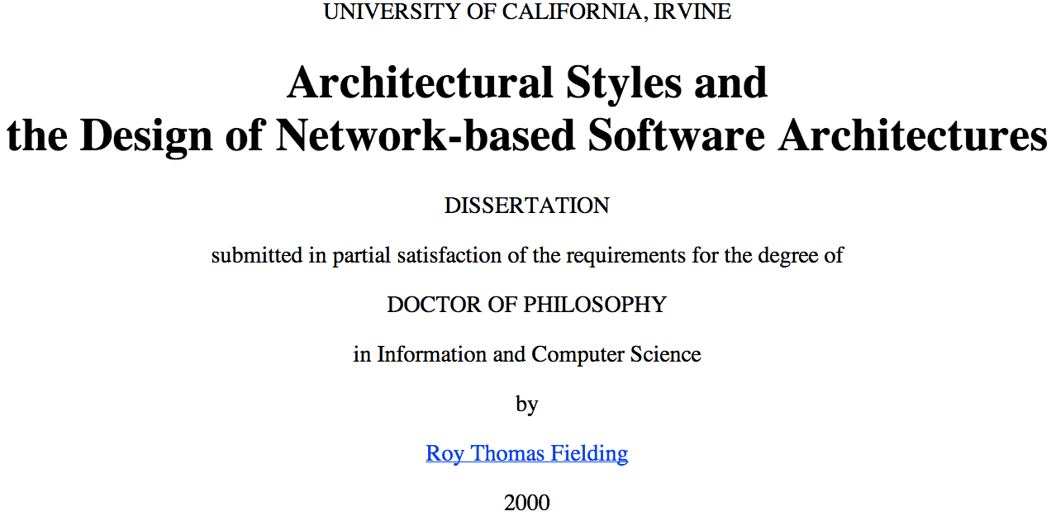
REST
Notes:
And then in 2000, Roy Fielding wrote his now famous dissertation. There is plenty of genius in REST—leveraging the strengths of HTTP. Thinking about how to address the problem of brittleness and contracts.
But remember this was 2000. Before all the things that we take for granted now even existed. Is Representational State Transfer, using Hypermedia As The Engine Of Application State really that important?
More info:
Feilding’s dissertation: http://www.ics.uci.edu/~fielding/pubs/dissertation/top.htm
2007 intro: http://www.infoq.com/articles/rest-introduction

Slide 8
The rise of…
Software as a Service
Web Mashups
Virtualization
User Experience
Mobile
Notes:
Since 2000, these are some of the big things that have happened…

Slide 9
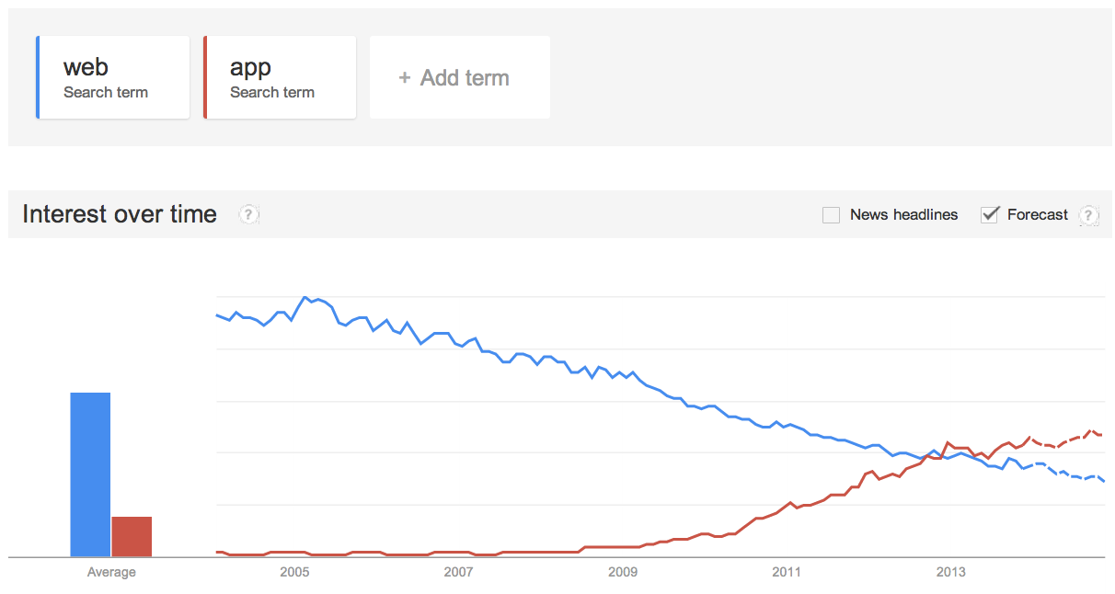
Web vs App
Notes:
We’ve moved beyond “web apis.”
Source: http://www.google.com/trends/explore?q=web#q=web%2C%20app&cmpt=q
What fit for the web, doesn’t necessarily fit for mobile.

Slide 10
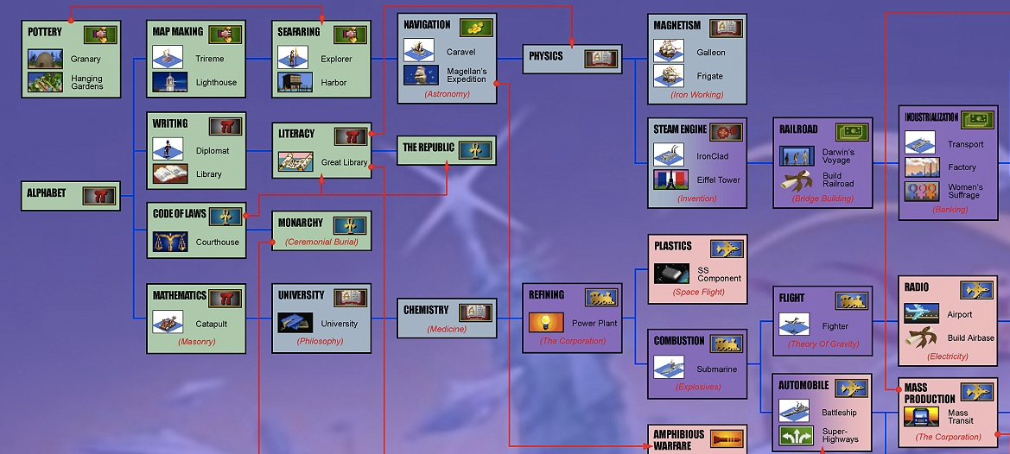
Technology unlocks technology…
Notes:
Now we’re deep into the dual revolutions of virtualization and mobile. They don’t show any signs of slowing down. If technology history is any guide, we should expect 10x growth over the previous generation.
And what’s coming next? Technologies unlock other technologies, just like in the game Civilization where you have to invent the wheel before you can invent a chariot.
http://www.civfanatics.com/images/civ2/poster/civ2chart.jpg

Slide 11

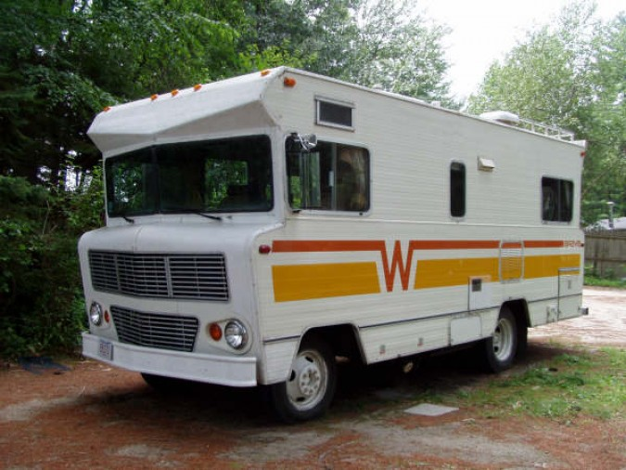
Gehry vs Winnebago
photo: uggboy
Notes:
REST is an architectural style.
We’ve been focusing on the architecture, how do we build these great structures, without thinking about the people who have to live in them. How do we make APIs a more pleasant place to be?
http://www.flickr.com/photos/45713725@N00/8573651373/in/photolist-e4CcRp-biQQKX-7YZVKs
http://kevinwarnock.com/2010/02/

Slide 12
Where are we now?
Notes:
Take all the things we’ve talked about around API design.

Slide 13
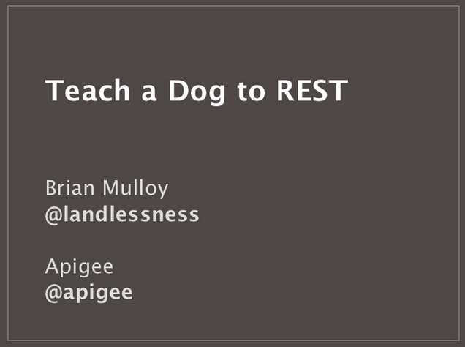

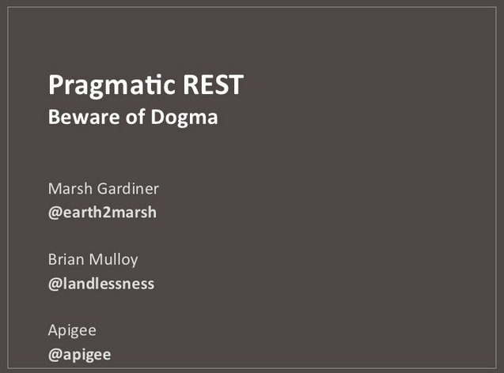
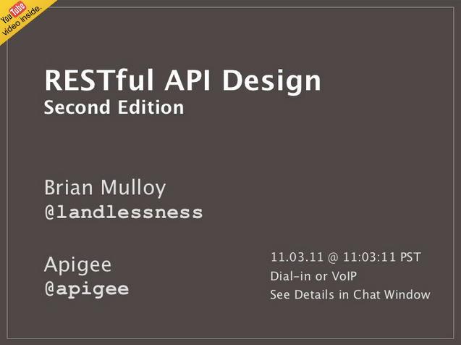
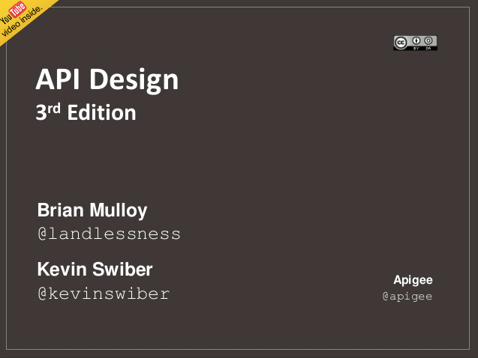
Refocusing API design
Notes:
We as in Apigee.

Slide 14
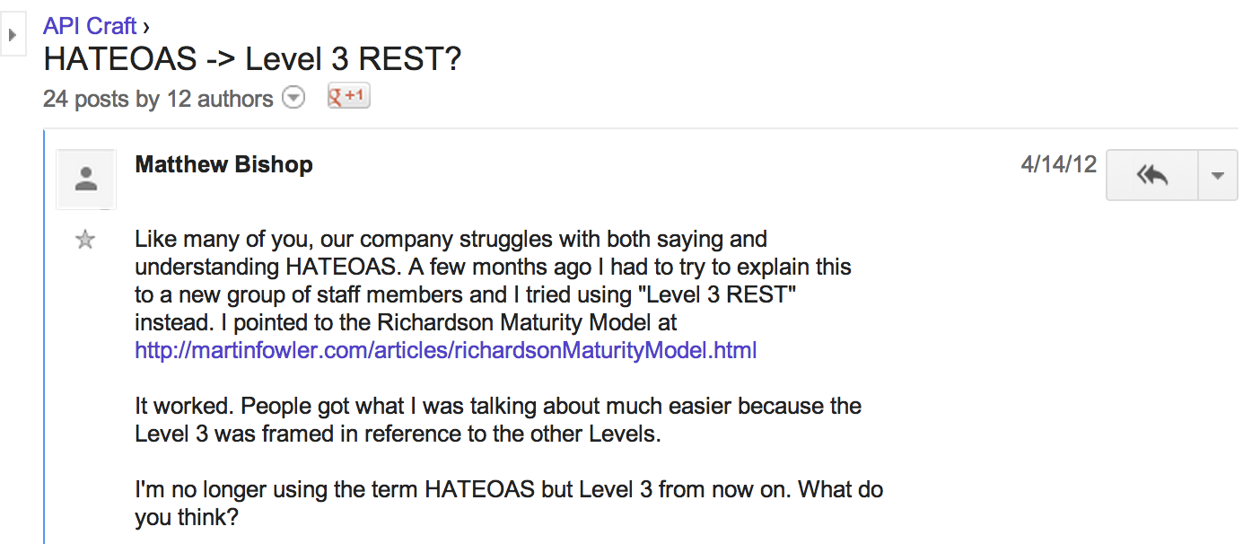
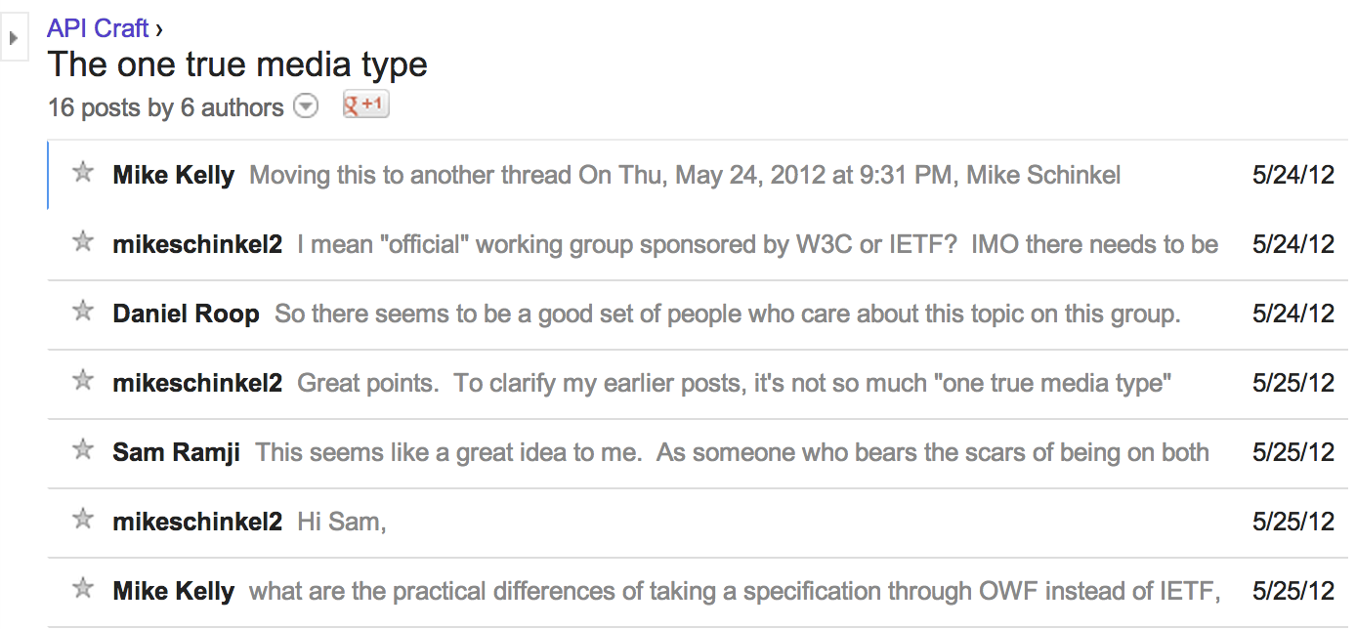
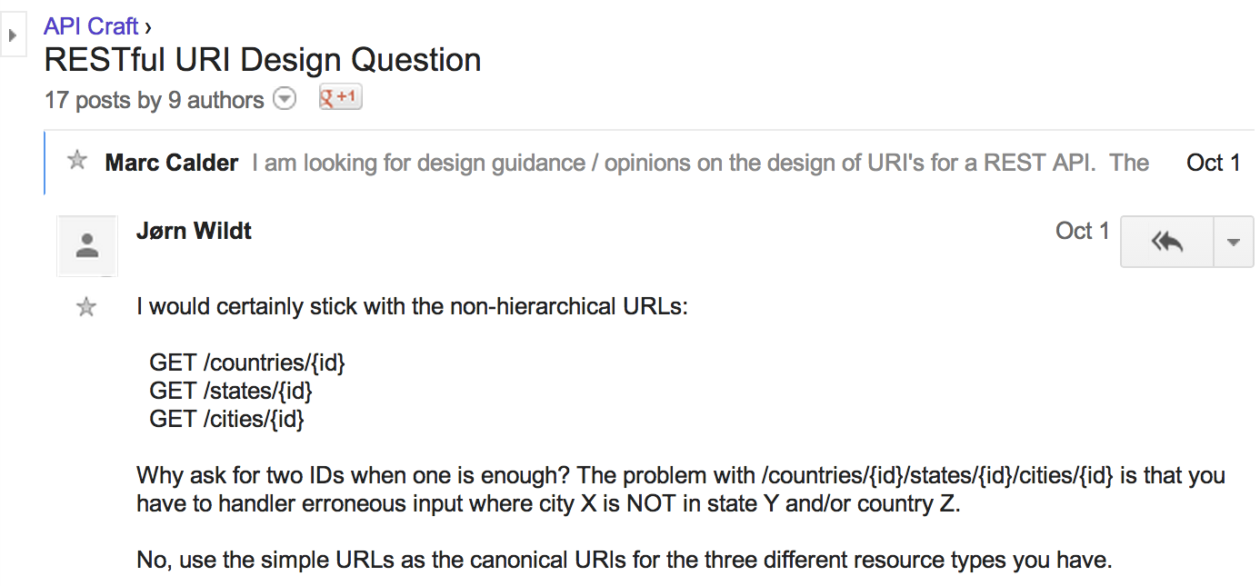
Passion (and controversy)
Notes:
API craft controversy. REST is overloaded. As much as anything, what we have is a crisis of naming. It’s not SOAP, but is it REST? Is it XML-RPC? JSON-RPC?
One True Media Type
https://groups.google.com/forum/#!searchin/api-craft/one$20true$20media$20type/api-craft/W7697igIhOs/-OEVHoIUYtoJ
HATEOAS -> Level 3 REST
https://groups.google.com/forum/#!searchin/api-craft/hateoas$20level$203/api-craft/alOJYQ5h-wM/XV5vCwg8cWMJ
RESTful URI Design Question
https://groups.google.com/forum/#!searchin/api-craft/RESTful$20URI$20Design$20Question/api-craft/2pYslqSicL8/bPfXL-gH-9wJ

Slide 15
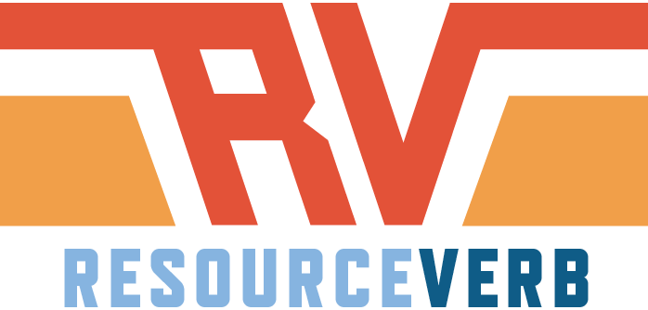
Design for adoption
Notes:
Adoption matters, whether you're planning an internal, partner, or open API.
Everything you do to make it easier for developers is good. Move hard things away from the client and onto server.
Whenever you are deciding between two patterns, pick the one that is easier for a developer to grok.

Slide 16
Resource
Addressing:
IP: 173.194.70.102 ➡ google.com
Twitter: 14352786 ➡ @earth2marsh
https://github.com/apigee
Notes:
URIs are interfaces
Obviousness
Every thing gets a resource, an address.
This is the naming of things. We have a long history of mapping people-friendly names onto machine ids.
There are only two hard things in Computer Science: cache invalidation and naming things. -- Phil Karlton

Slide 17
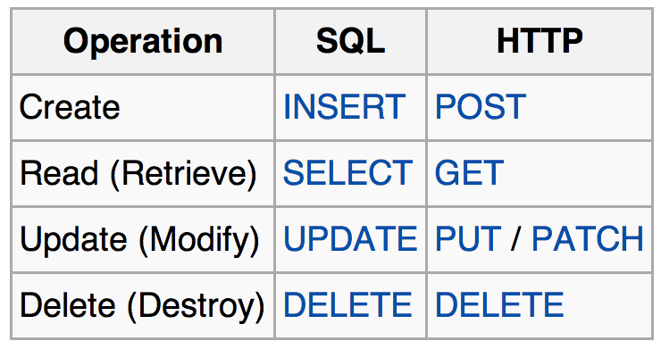
Verb
Notes:
So we have things. Things are nouns. Things have a state.
Now we need to be able to take primitive actions on those things. Things are stored somewhere. Our basic palette of verbs gives us CRUD.
http://en.wikipedia.org/wiki/Create,_read,_update_and_delete

Slide 18
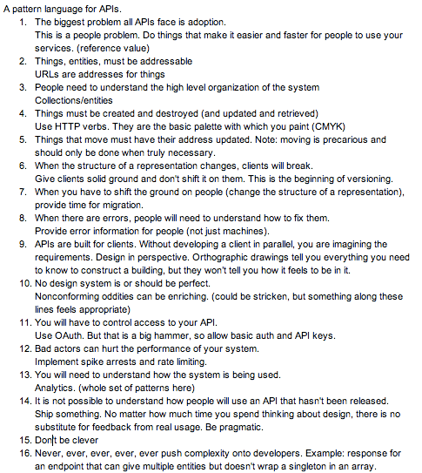
General philosophy
Notes:
There has been a lot of thought about this. We’ll be adding these patterns to resourceverb.com as we build it out over the next few weeks.

Slide 19
Applying RV patterns
Notes:
Being pragmatic, let’s spend some time to apply some of them directly.

Slide 20
Collections and entities
https://api.stripe.com/
Summary of Resource URL Patterns
/v1/charges
/v1/charges/{CHARGE_ID}
/v1/coupons
/v1/coupons/{COUPON_ID}
/v1/customers
/v1/customers/{CUSTOMER_ID}
Notes:
Similar things belong in groups
Case sensitivity
Avoid hierarchies
https://stripe.com/docs/api

Slide 21
Versions
Twilio
/2010-04-01/Accounts/
Salesforce
/services/data/v29.0/sobjects/Account
Foursquare
/v2/users
Notes:
When the structure of a representation changes, clients will break. Give clients solid ground and don't shift it on them. This is the beginning of versioning.
A version indicator is the replacement for what we used to call contracts. Think of it more like a warranty. We promise not to change the response in ways that will break your client. Think of it as a generation of your API, and you'll commit to always support one version back during a transition.
simple
in url
not dates
/i/
Not quite like Twitter. Definitely not like Salesforce. More like Foursquare or GitHub
http://www.lexicalscope.com/blog/2012/03/12/how-are-rest-apis-versioned/

Slide 22
Query parameters
Twitter
/1.1/search/tweets.json?q=%23superbowl &result_type=recent
Notes:
Query is for simple name/value pairs that enable fine-tuning the controls.
The thing to be careful of is that the query string is part of the resource. This can affect your caching strategy.
Query parameters are a great way

Slide 23
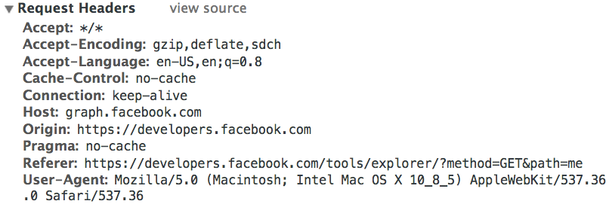
Header parameters
Notes:
Information about the request itself, controlling compression, sending the authentication, this stuff is perfect for the header.
Won’t change the code that you have to parse it. Doesn’t change the resource.
Body is for complex objects.
If you can’t fit it in the query or the header, put it in the body.

Slide 24
Conveniences
Facebook
/me
LinkedIn
/v1/people/~
Foursquare
/v2/checkins/recent
Notes:
/me, /users/me are good conveniences for developers (prefer FB to LI). Conveniences are fine time to break the collection/entities pattern.
Facebook: https://developers.facebook.com/docs/reference/api/user/
LinkedIn: http://developer.linkedin.com/documents/profile-api
Foursquare: https://developer.foursquare.com/docs/checkins/recent

Slide 25
Formats
SoundCloud
/users/3207
/users/3207.json
Notes:
Formats can benefit from obviousness. Be json-only if you can.
.json (default) or .xml
XML for legacy. SoundCloud is old enough that they have xml as the default. Today they’d use JSON as the default and might not use XML at all
http://developers.soundcloud.com/docs/api/reference#

Slide 26
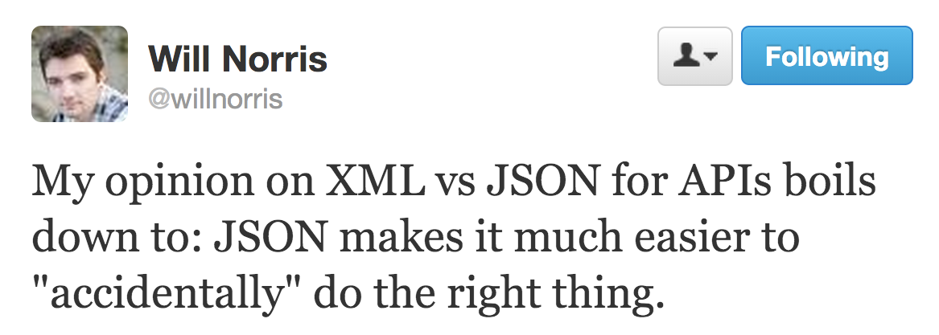
Formats

Slide 27
Actions
Facebook
/search?q=watermelon&type=post
Hypothetical
/convert?from=EUR&to=CNY&amount=100
DigitalOcean
/droplets/{droplet_id}/reboot
Notes:
Other non-resourcey stuff
Long running processes. Reboot…
Avoid it. But don’t kill yourself. How many euros is 12 dollars?
Slippery slope toward RPC
https://developers.facebook.com/docs/reference/api/search/
https://developers.digitalocean.com/

Slide 28
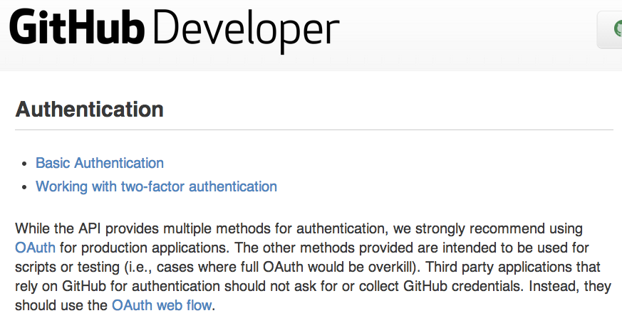
Authentication
Notes:
OAuth is awesome for production grade apps. There is nothing better. But if I want to write a quick script to access my data, OAuth is a big barrier to cross before I can start playing with an API. Why not do what GitHub does and let the developer choose what works for him/her? Consider adding rate limits to discourage abuse and/or an X-Not-Production-Grade response header.
Flexibility / usability tradeoff.

Slide 29
Dates
Twitter
"created_at": "Thu Nov 03 05:19:38 +0000 2011"
Bing
"DateTime": "2011-10-29T09:35:00Z"
Foursquare
"createdAt": 1320296464
Notes:
ISO-8601
More info: http://en.wikipedia.org/wiki/ISO_8601

Slide 30
Filters
Facebook
/me?fields=name,birthday,photos.limit(10).fields(id,picture),videos.type(tagged).limit(10).fields(id, source)
Notes:
https://developers.facebook.com/docs/reference/api/field_expansion/

Slide 31
Pagination
Facebook
offset, limit
Twitter
page, rpp
LinkedIn
start, count
Notes:
Limit & offset

Slide 32
Pagination
Facebook
offset, limit
Notes:
Anyone who has queried a database understands this naming.

Slide 33
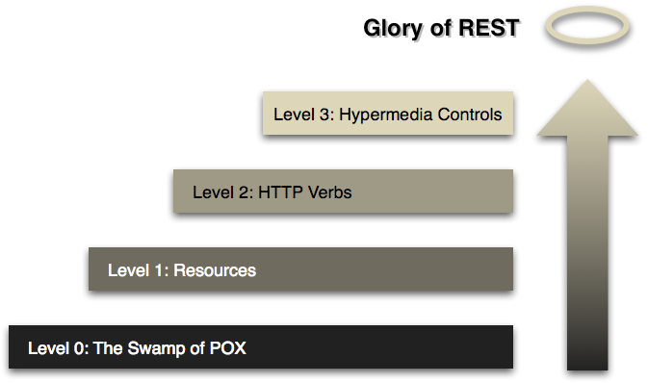
HATEOAS and the Hypermedia Constraint
Notes:
Having to start at the root and crawl the graph every time? HATEOAS is the right problem to solve if the biggest problem is clients that are breaking. But since the biggest problem is adoption, don’t get distracted by HATEOAS. (FWIW, RV and REST are compatible, RV just places the adoption constraint above the Hypermedia As The Engine Of Application State constraint.)
More info: http://martinfowler.com/articles/richardsonMaturityModel.html

Slide 34
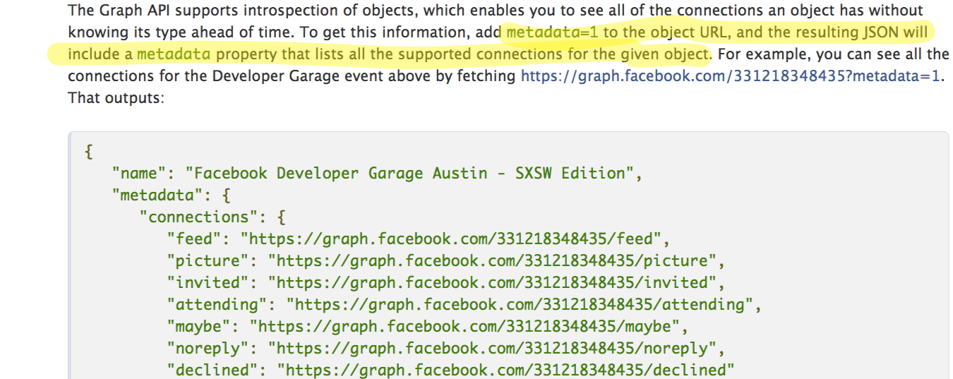
Hypermedia
Notes:
Hypermedia has a place.
Pagination. Next / previous. Facebook style. Metadata=true
Relationships
Business process
More info: https://developers.facebook.com/docs/reference/api/introspection/

Slide 35
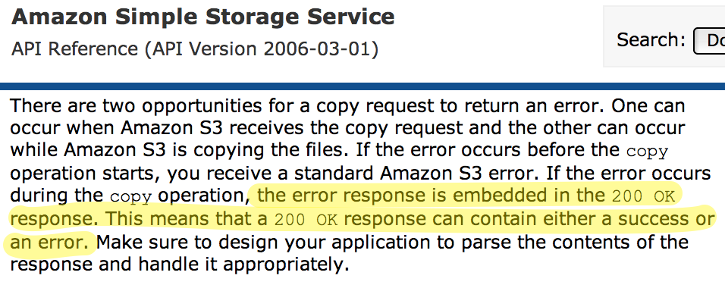
Great moments in mishandled error code history
Notes:
Problem: 200 can be cached!
Source: http://docs.aws.amazon.com/AmazonS3/latest/API/RESTObjectCOPY.html
More info: http://tech.blog.box.com/2013/04/get-developer-hugs-with-rich-error-handling-in-your-api/

Slide 36

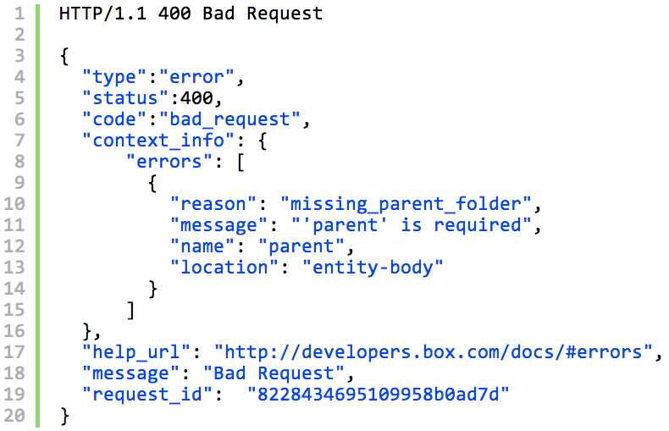
Errors
Notes:
When there are errors, people will need to understand how to fix them. Provide error information for people (not just machines). Look to Box, who did a very thoughtful redesign of their errors.
More info: http://tech.blog.box.com/2013/04/get-developer-hugs-with-rich-error-handling-in-your-api/
Also: http://www.mnot.net/blog/2013/05/15/http_problem

Slide 37



SDKs
Notes:
In the view-source world of the web + OAuth, providing a JavaScript SDK is a nice-to-have.
If you’re focused on mobile, there is a higher expectation that you will offer an Android / iOS SDK.
Just don’t use an SDK to mask the messiness of your API design. Because with SDKs, you have additional burdens of documentation, support, and testing.

Slide 38
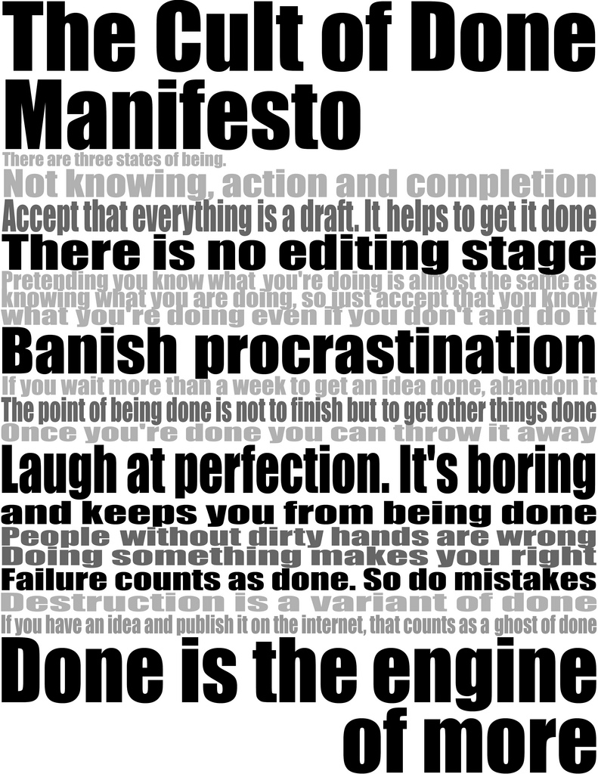
Perfect is the enemy of done
Notes:
You won’t get meaningful feedback from users until you get it out into the world. You have all the mechanisms you need to start learning. Versioning can help you.
http://www.flickr.com/photos/joshuarothhaas/3327763912/sizes/l/

Slide 39



Questions
rv@apigee.com, @ResourceVerb
brian@apigee.com, @landlessness
marsh@apigee.com, @earth2marsh
Notes:
Consider the developer adoption perspective when wrestling with API design problems.
Check out resourceverb.com for more background and patterns, and get in touch with us through the channels you find there.
… and start making better APIs.

Slide 40
Thank you
Marsh Gardiner, @earth2marsh
Brian Mulloy, @landlessness

